Slide 1

An offensive kill chain to reveal client's financial status
Oleksandr Kazymyrov
Booster 2024

Slide 2
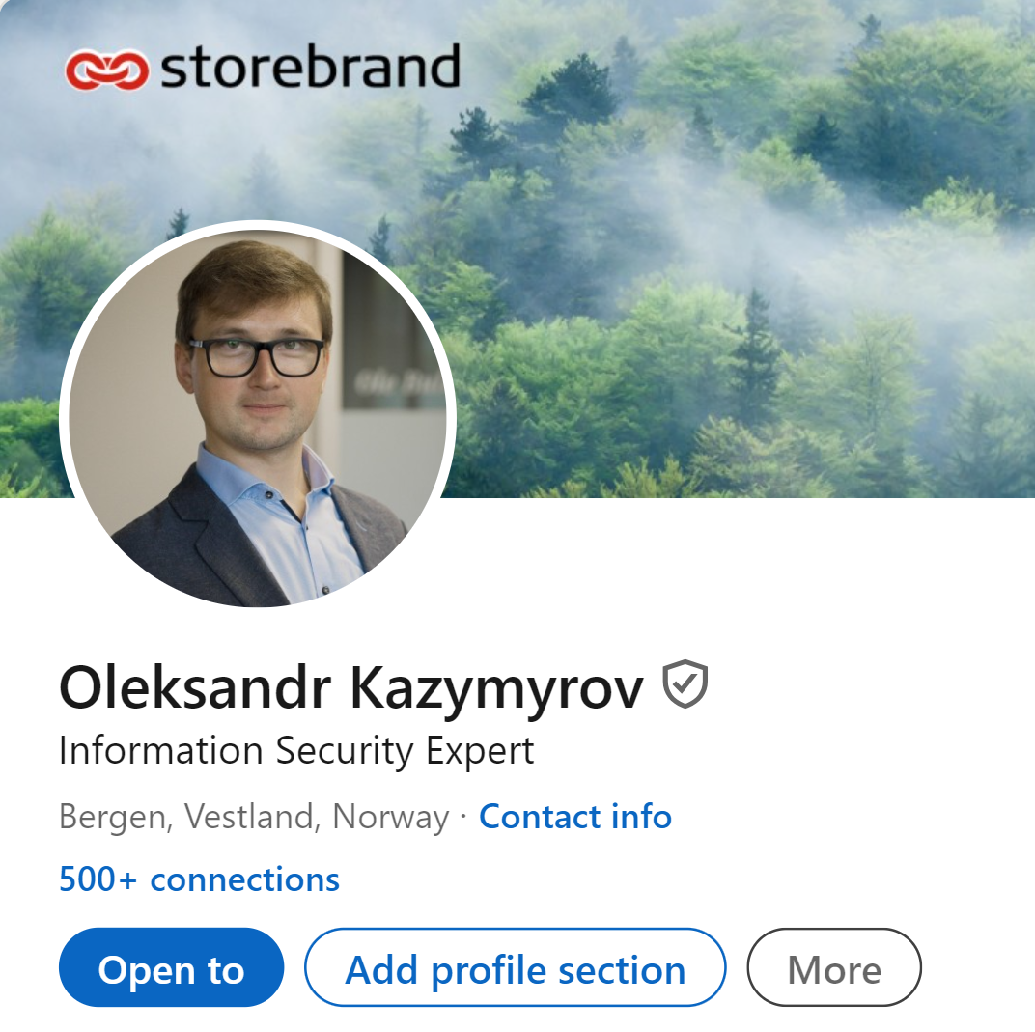
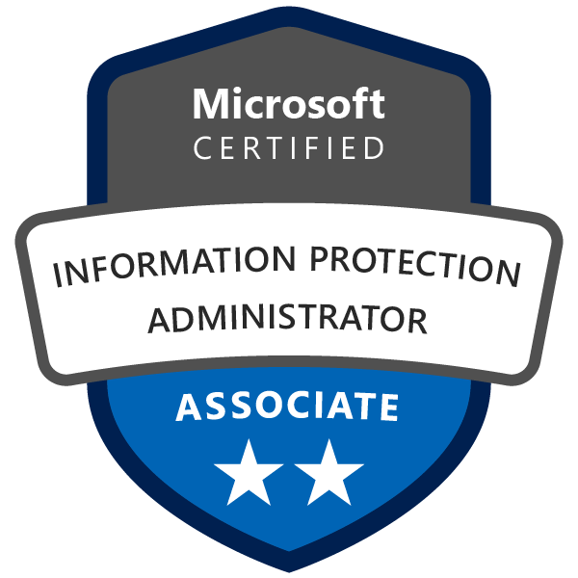
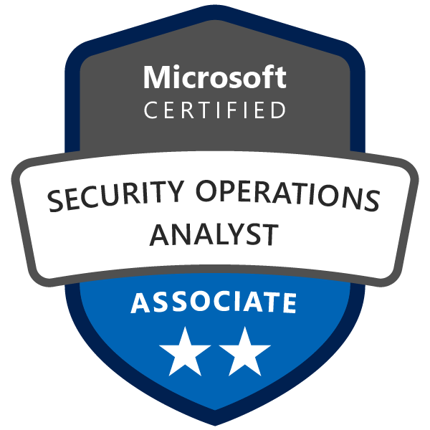
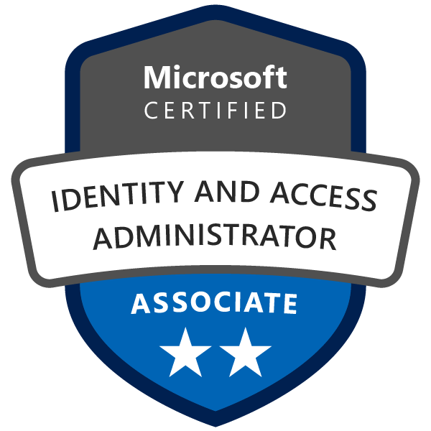


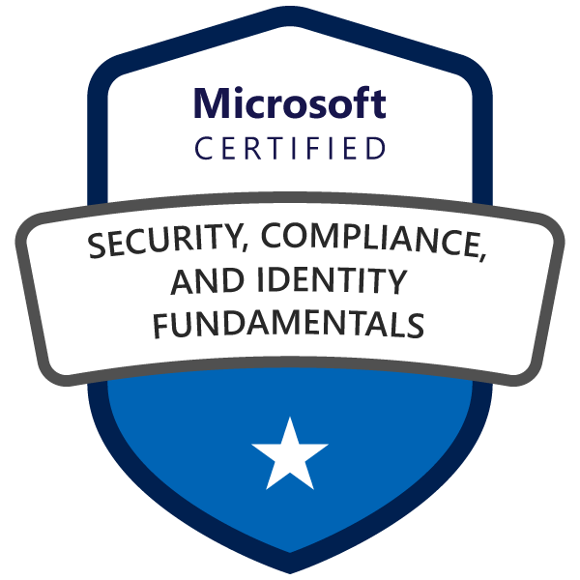
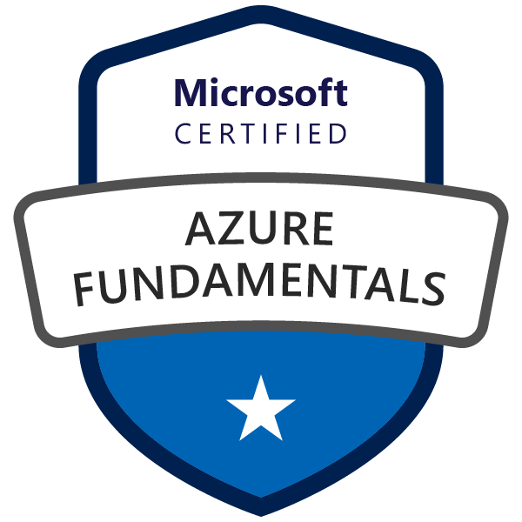
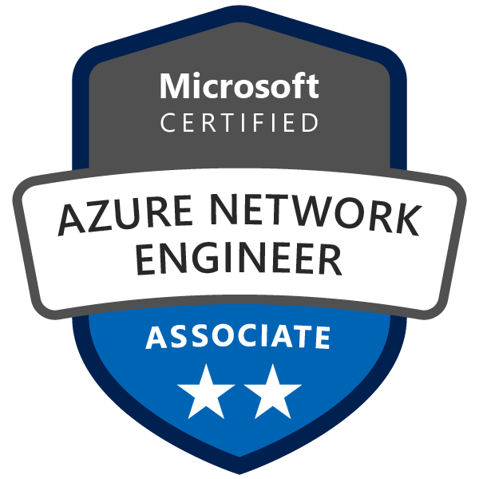



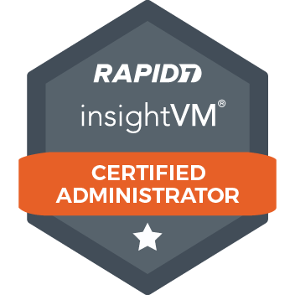
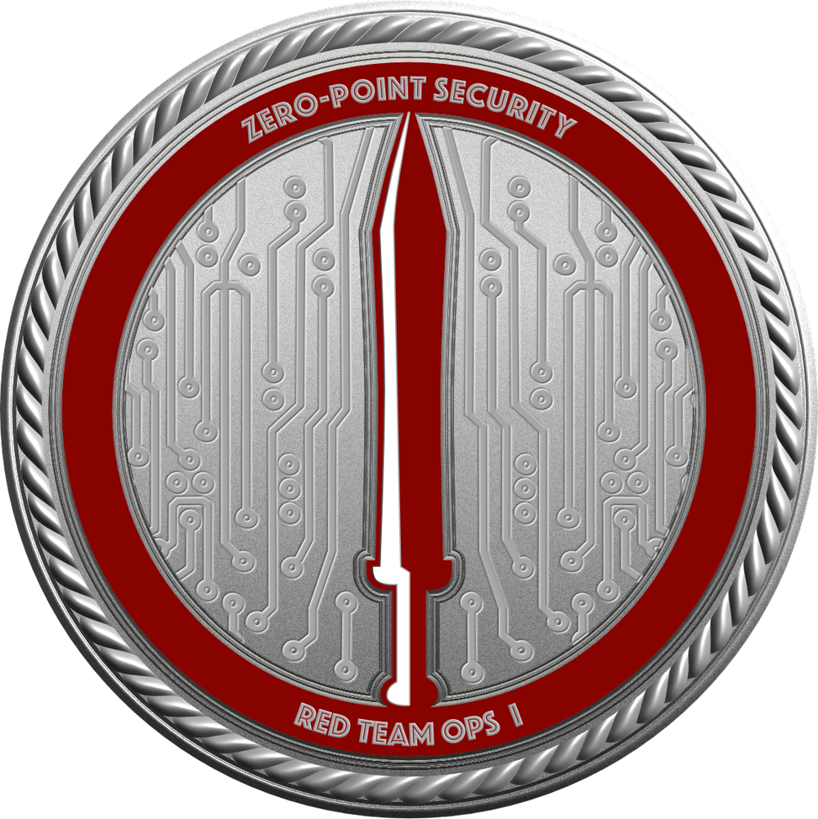
Who am I?
???

Slide 3
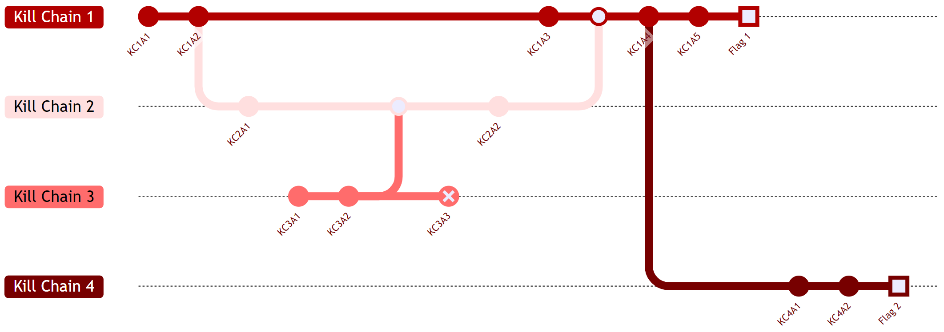
What is a cyber kill chain?

Slide 4
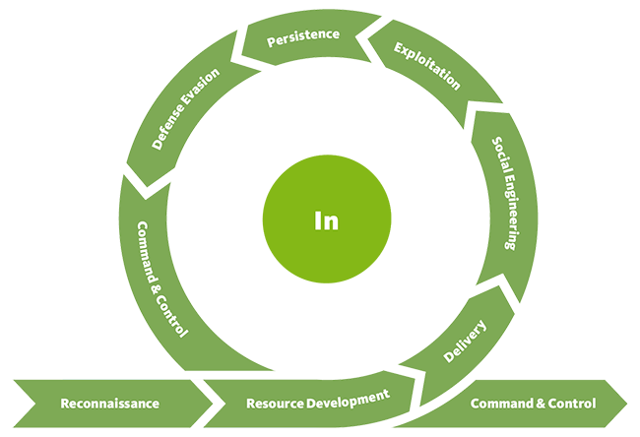
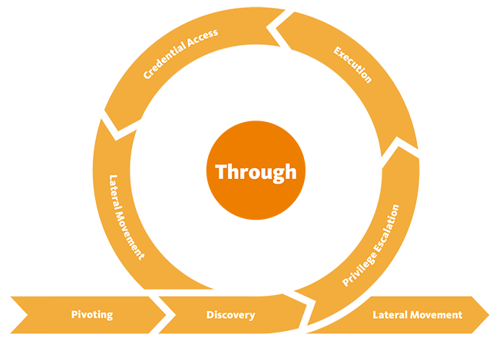
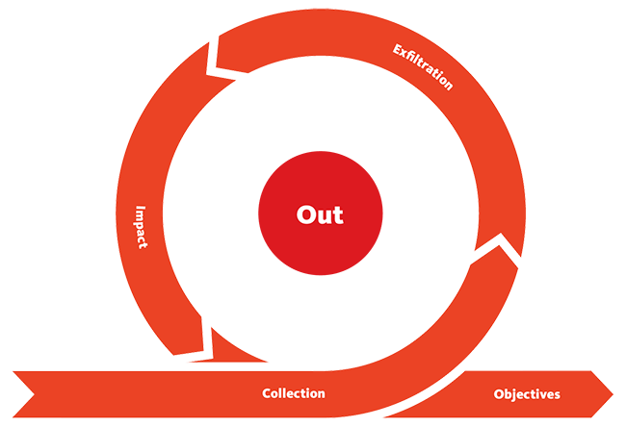
The unified kill chain
Source: https://www.unifiedkillchain.com/

Slide 5










Kill chain: from shared food courts to falling stocks
3. Become an insider threat by imitating business casual dress code
5. Exploit
network segmentation weaknesses to access production systems
1. Use Google Maps to find entry points
7. Combine weak access management with obtained credentials to access customer master records
9. Transfer dumped records to an external cloud provider
2. Access office spaces by following a person
4. Bypass network security controls
6. Perform password spraying to obtain credentials
8. Dump customer master records by exploiting web APIs
10. Use public sources to spread information about the successful attack to cause financial and/or reputational damage.

Slide 6





Tactics, techniques and impact
Initial
Access (In)
Lateral Movement (Through)
Collection and exfiltration (Out)
Reconnaissance
Network access
Exploit
web apps
Malware
Supply chain
attacks
Lateral
movement
Tailgating
Exploit
segmentation
Collection
Reputational and financial losses
Ransomware
Identity
thief
Insider threat
Credential Access
Exfiltration
Impact

Slide 7


Kill chain to reveal client's financial status
2. Obtain remote access to corporate resources
4. Combine weak access management with the insider or valid credentials to access customer master records
6. Transfer dumped records to an external cloud provider
1. Perform OSINT to find initial vectors for social engineer attacks.
3. Exploit network segmentation weaknesses to access production systems
5. Dump customer master records by exploiting web APIs
7. Use public sources to spread information about the successful attack to cause financial and/or reputational damage.

Slide 8




Threat scenarios for remote access
1. A hacker uses a spear phishing attack to target employees.
3.b
2
3.b The hacker may choose to install a backdoor on the computer and get a separate session.
2. A hacker with the help of the insider threat deploys malware on remote computer or obtain a legitimate session.
2
1. An adversary offers a deal to an employee who can't refuse it.
1
1
3
2
3. When an employee uses remote access, the hacker hijacks/steals the session.
2. An employee opens a malicious email attachment, which triggers the malware within to establish a connection back to the attacker's server. Consequently, the adversary gains unauthorized access and control over the employee's computer.
Phishing
Insider threat

Slide 9
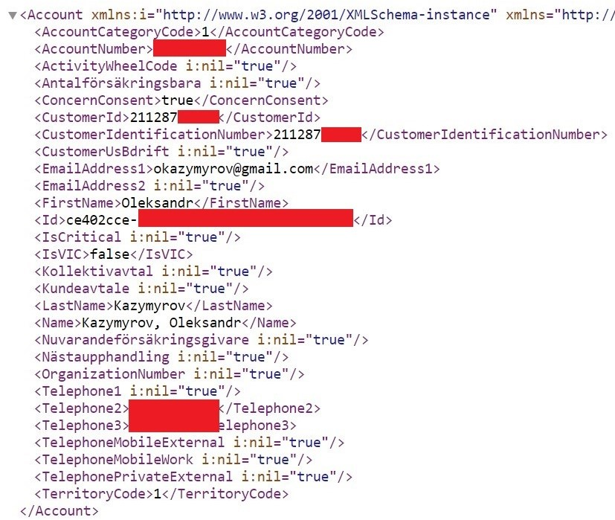
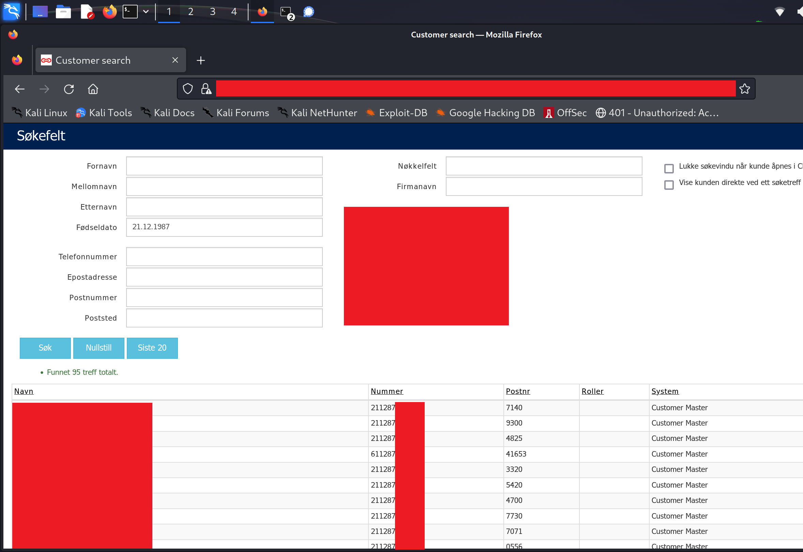
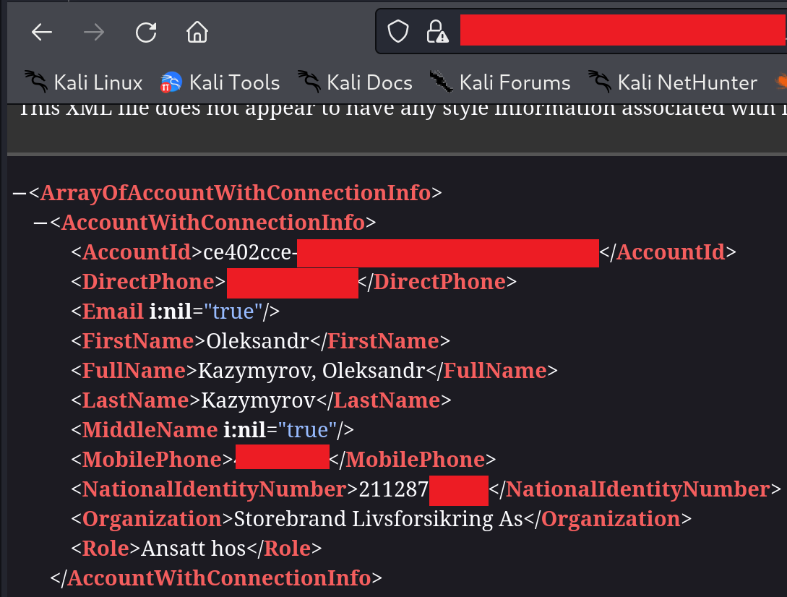
Kill chain: customer master records
Vulnerability
Access control was implemented on an external/internal basis. No roles or further segregation in the internal network.
2.b Details
1. A web application to find customers.
2. APIs used in the customer search web application. The hacker could dump CM data of all Storebrand's customers.
2.a Search

Slide 10
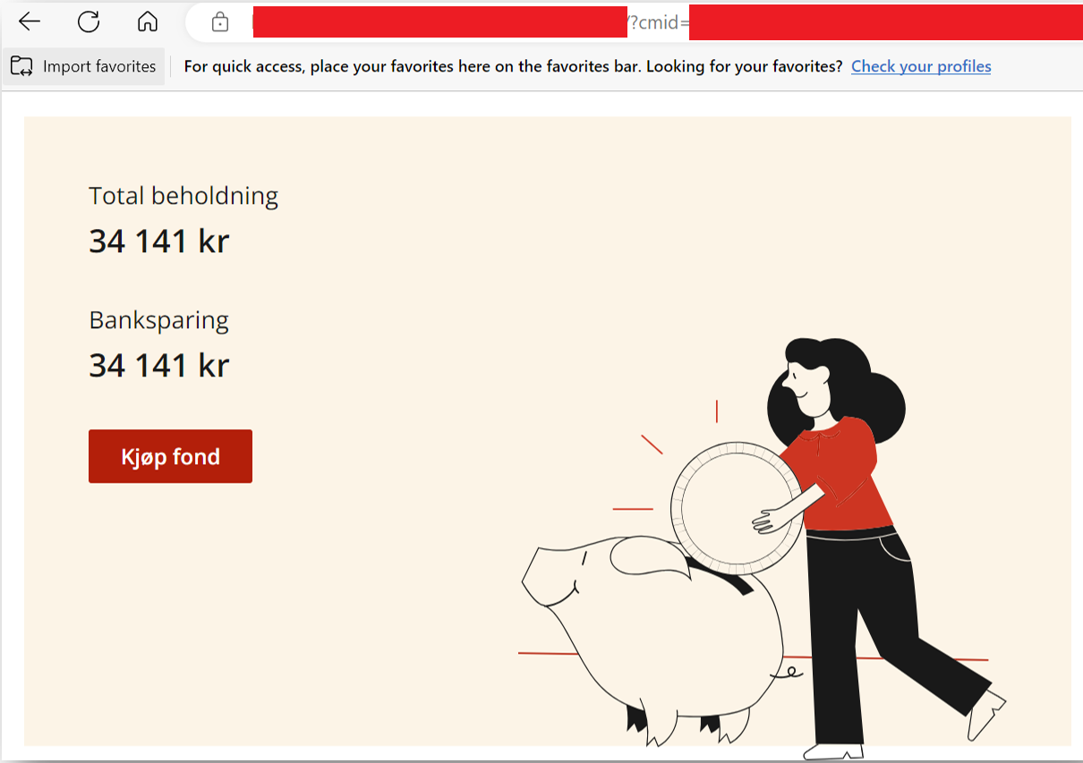
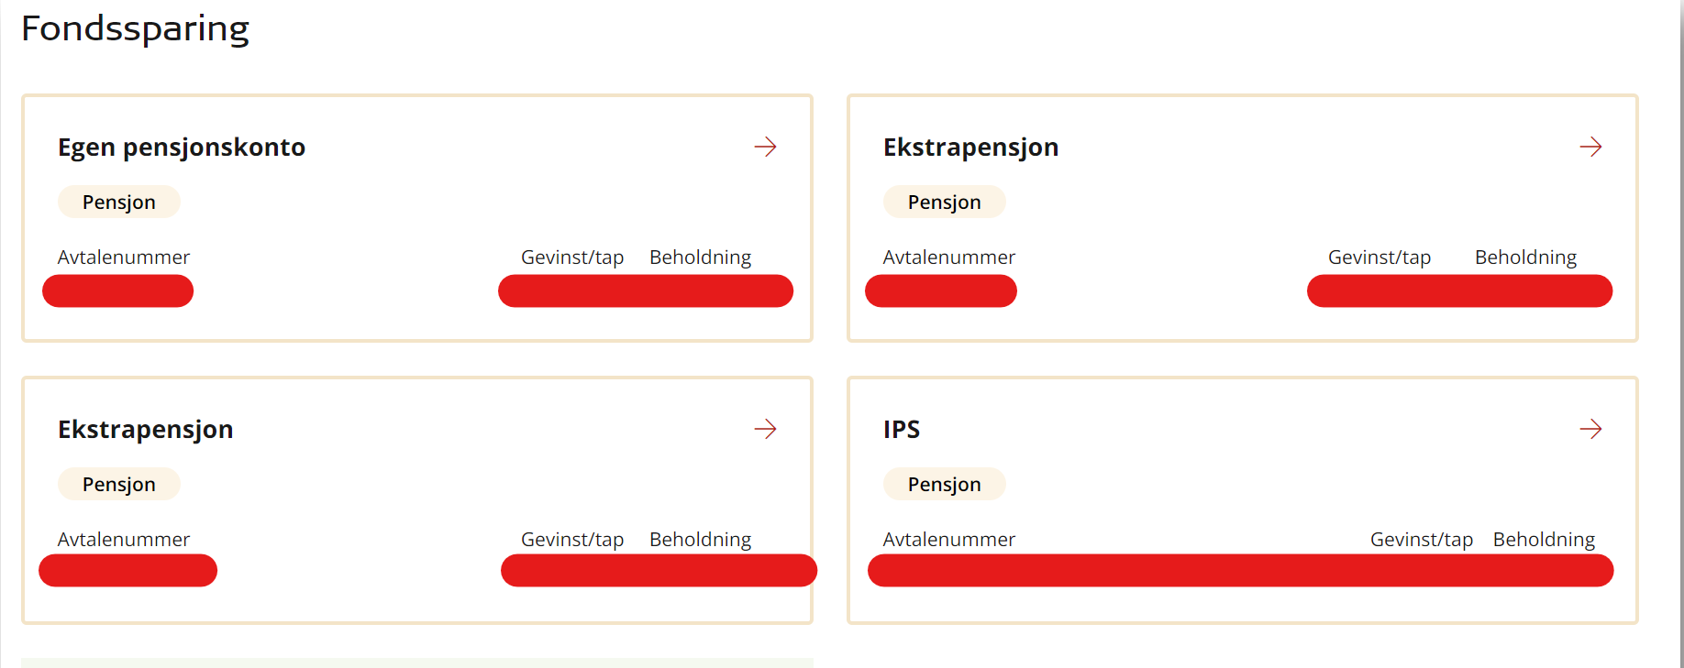
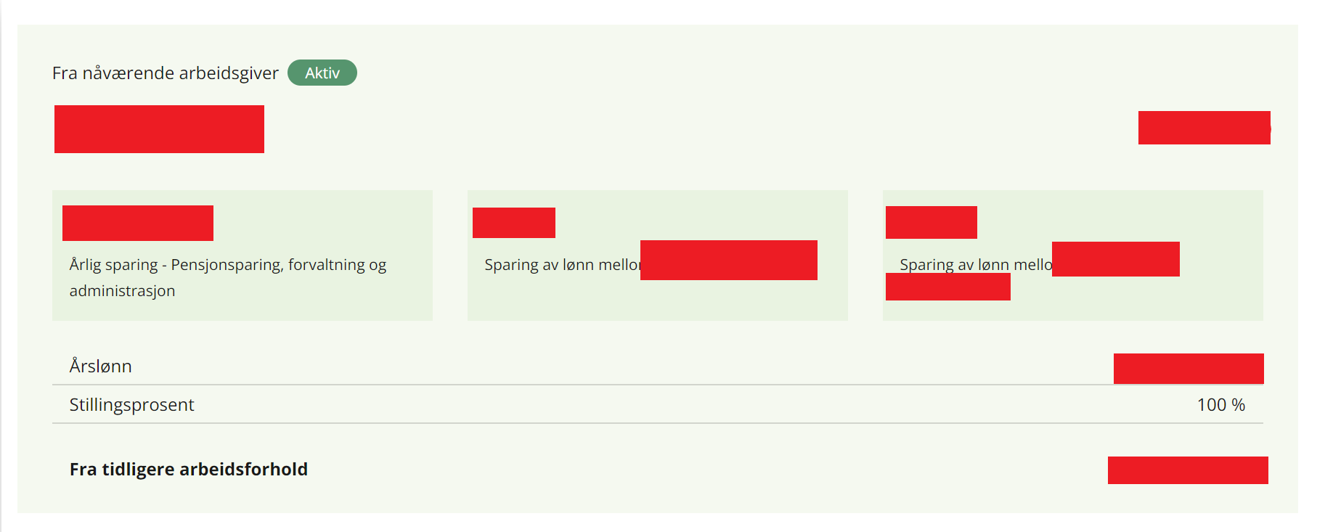
Attack vectors: targeting new platforms in the cloud
Vulnerability
Lift and shift migrations without continuous security tests of changes.
3. By adding "?cmid=" on the new web application any employee could obtain information about customer savings in Storebrand.
4. The combination of several services provides even more information about the savings and financial status of any client.

Slide 11
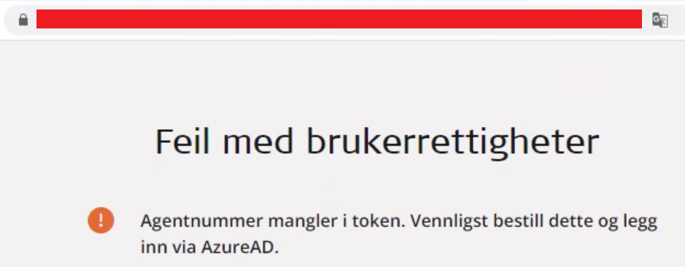
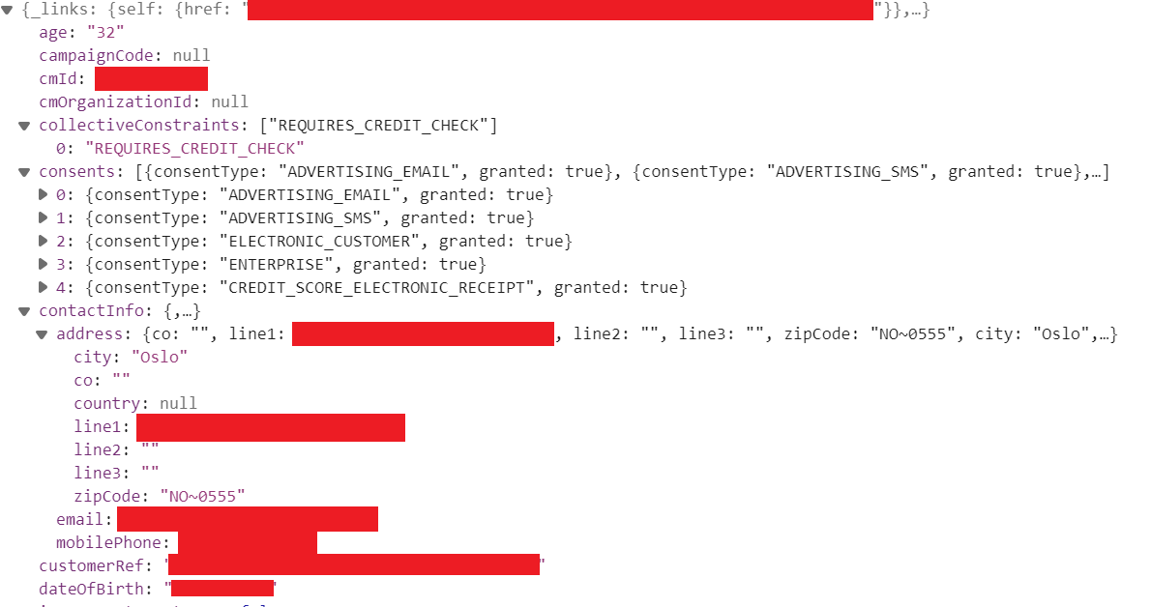
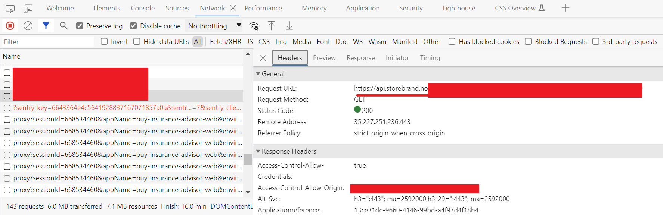
Attack vectors: extracting information after a quick fix
Vulnerability
Fire fighting is the main approach to improve security. Many security updates have been implemented during the cloud migration, but some fundamental security issues (such as secure development or application/API security) are still ongoing.
5. An insider could obtain customer master records and other product-related information through the API (backend) even if the browser (frontend) throws an error.

Slide 12
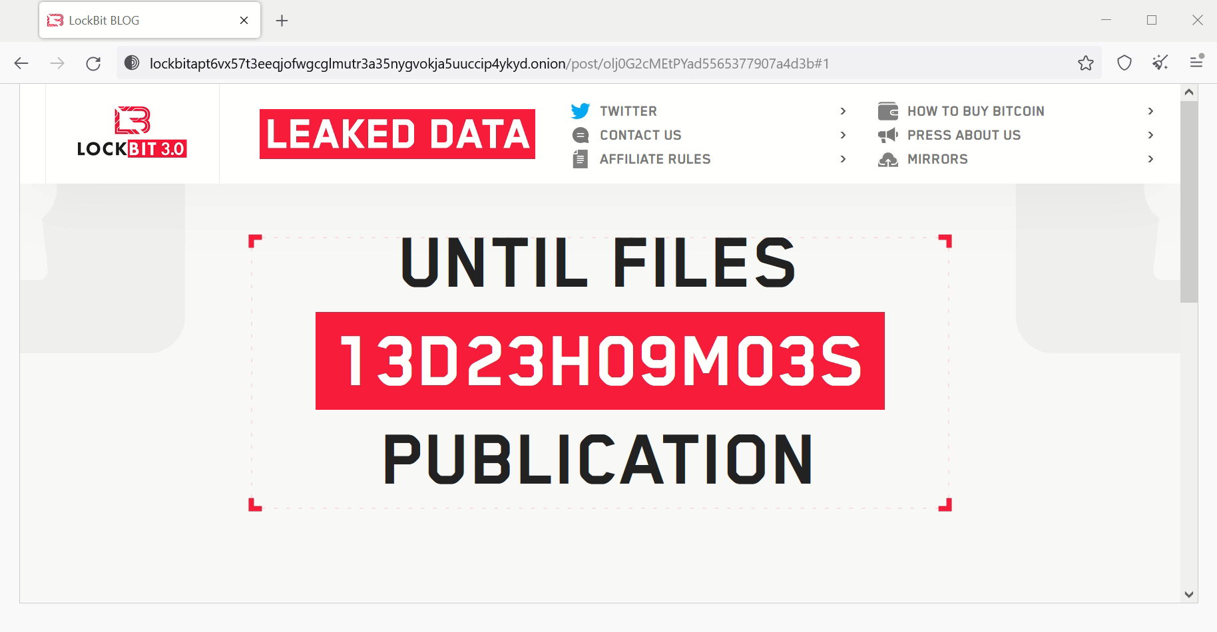

Slide 13
Mapping to cybersecurity domains
IAM
IAM
DLP
2. Obtain remote access to corporate resources
4. Combine weak access management with the insider or valid credentials to access customer master records
6. Transfer dumped records to an external cloud provider
LEE
LE
1. Perform OSINT to find initial attack vectors
3. Exploit network segmentation weaknesses to access production systems
5. Dump customer master records by exploiting web APIs
7. Use public sources to spread information about the successful attack to cause financial and/or reputational damage.
IAM
IAM
SE
NS
IAM
IAM
SE: social engineering; IAM: identity and access management; NS: network segmentation; DLP: data loss prevention; LE: law enforcement.

Slide 14

Identity
Who/what have access to resources?
Access
Are they authorized to interact with the resources?
Management
Revoke access in swiftly manner.

